Slide 1

print() - statement

Slide 2
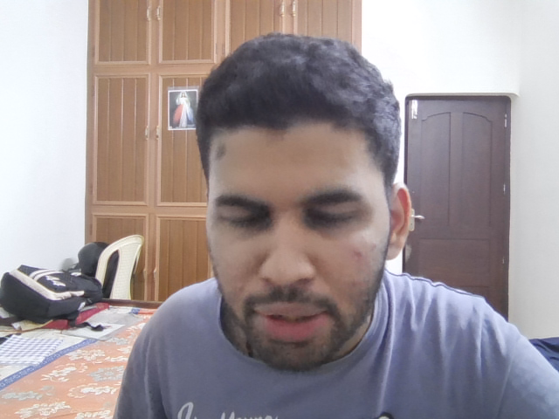
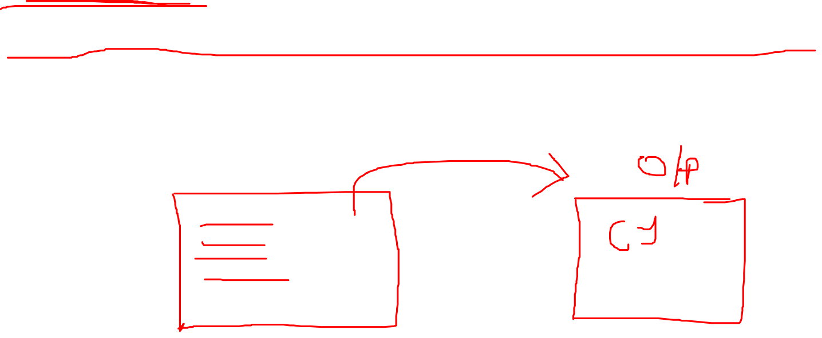
print()
It is a function.
Duty of print() is to put up what is told in the output screen
Imagine it like a chalkboard where you can write anything you desire

Slide 3
